Slide 1
Efficient Data-Driven Methods for Legal Document Summarization, Similarity, and Role Labelling
SHRUTI SHREYASI
19EC10086
Advisor: Prof. Partha Pratim Chakrabarti

Slide 2
Problem Statement
The ultimate objective of this project is to build a legal custom search and analytics system which is capable of summarizing legal documents and preparing basic, labelled and a structured summaries, role labelling and retrieving similar documents

Slide 3
Why summarization?
There is 1 Supreme Court, 25 High Courts and 672 District Courts in India. The total number of judgements per year is very high.
The length of legal documents is very long.
The length of legal corpus is very huge.
The annotations are subjective.
It is difficult to find legal experts for annotation.
No uniform format for judgements is followed across courts.

Slide 4
Role labels
These are the seven standard role labels in legal documents:
FAC : Fact
PRE : Precedent
STA : Statute
RPC : Ruling by Present Court
RLC : Ruling by Lower Court
RC : Ruling by Court
ARG : Argument
Ratio : Ratio of decision

Slide 5
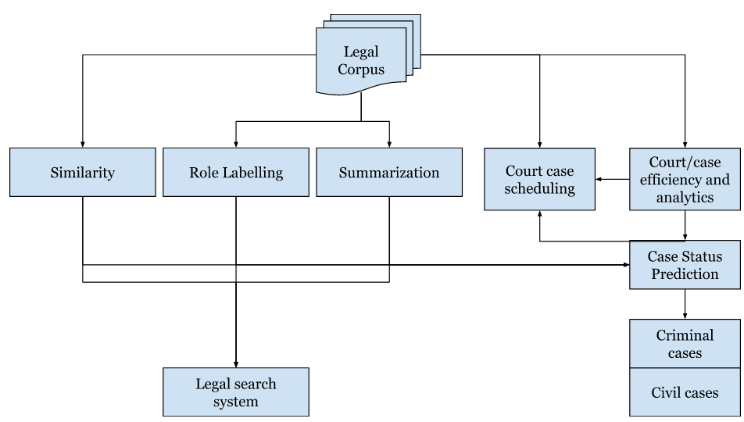
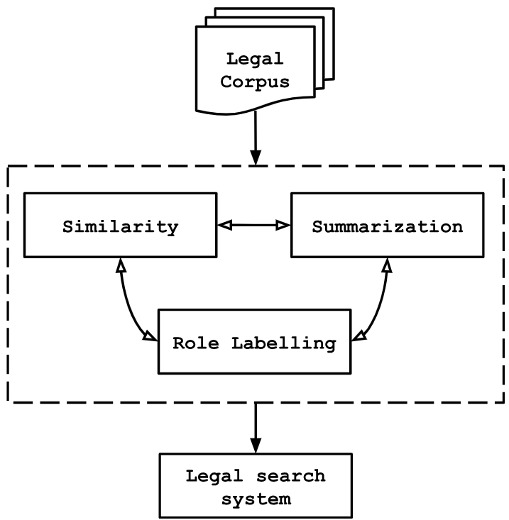
The Triad

Slide 6
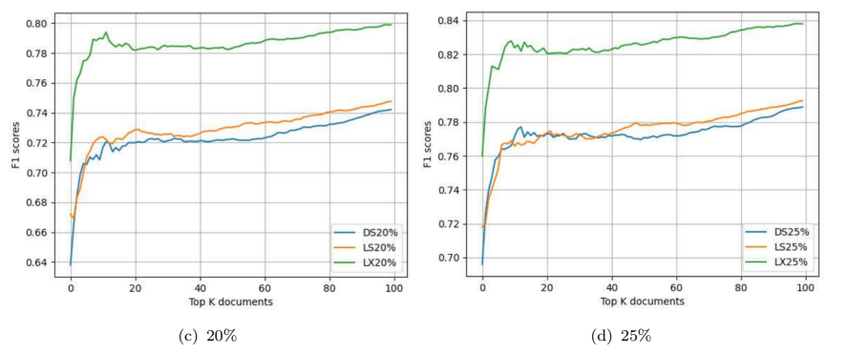
Triad studies: Summarization and Similarity

Slide 7
Role labelling: Rule based approaches
• STA follows the RegEx <section> of the <act> or <item> of the <schedule>
• PRE follows RegEx (____ / (____ vs/v. ____)), year, precedent(AIR/ SCR/ IPC...), number
• PRE -> Ratio/RC
• ARG -> Ratio -> ARG -> PRE -> Ratio
• FAC -> (RC -> FAC)* -> (Ratio/ARG -> PRE)+ -> RC

Slide 8
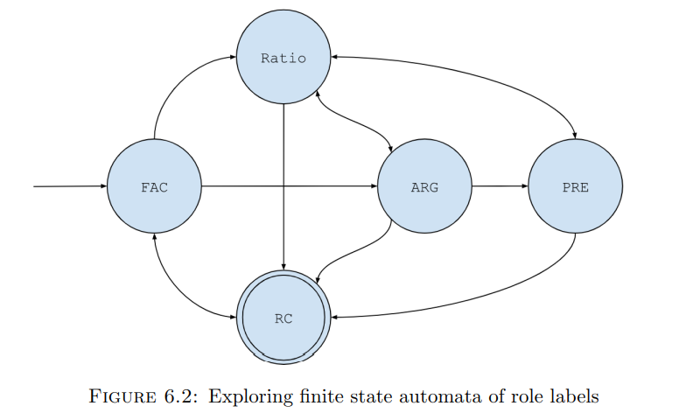

Slide 9
Role labelling: Clustering based approaches
The optimal number of clusters was found to be seven
There was minimal cluster overlap qualitatively
Intuitively matches the number of legal role labels
The topic classes for each cluster were studied qualitatively
Observation: clusters mapped one-to-one to the classes

Slide 10
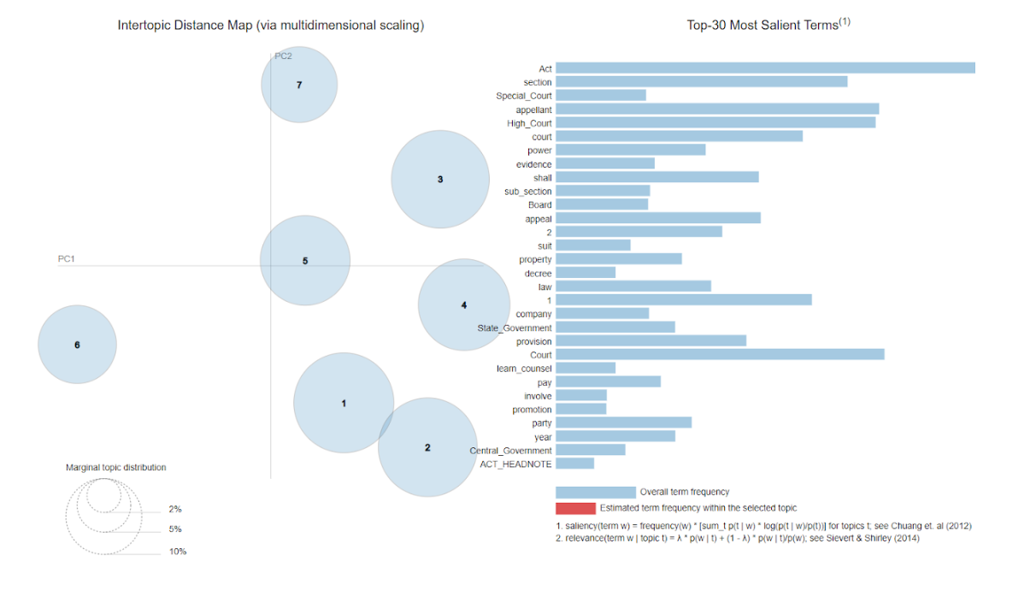

Slide 11
Cluster | Role label | Topic classes
1 | STA | act, section, sub_section, vs, article
2 | PRE | act, section, sub_section, vs, article
3 | Ratio | evidence, appear, suit, order, file, claim, involve, say
4 | ARG | consider, question, Act, jurisdiction, require, give
5 | RC | find, promotion, give, shall, decree, service, granted
6 | Metadata | Act_Headnote, Judgement, Citation
7 | FAC | every sentence falls under that category

Slide 12
Knapsack Summarization Algorithm
No. | Steps | Algorithm | Description
1 | Clustered the document into 7 clusters | Latent Dirichlet Allocation | Topic distribution from LDA was used to find cluster assignments
2 | Obtained summary for each cluster | PageRank | Used TextRank summarizer to remove sentences whose neighbors have been selected
3 | Took a union of all cluster summaries and Lexrank summary | LexRank | To incorporate sentences which might have been missed by LexRank
4 | Selected sentences to form summary | Knapsack | Selected sentences to maximize similarity with original document
No. | Steps | Algorithm | Description
1 | Clustered the document into 7 clusters | Latent Dirichlet Allocation | Topic distribution from LDA was used to find cluster assignments
2 | Obtained summary for each cluster | PageRank | Used TextRank summarizer to remove sentences whose neighbors have been selected
3 | Took a union of all cluster summaries and Lexrank summary | LexRank | To incorporate sentences which might have been missed by LexRank
4 | Selected sentences to form summary | Knapsack | Selected sentences to maximize similarity with original document

Slide 13
.5
.5
.7
.7
.4
.4
.8
.8
2
2
.9
.9
1.5
1.5
.7
.7
.4
.4
.7
.7
1.4
1.4
Cluster summary using PageRank
Cluster summary using PageRank
Cluster summary using PageRank

Slide 14
Setting a baseline for the study
Length of LexRank Summary | ROUGE F1 Score
0.5E | 0.49414
0.75E | 0.63041
E | 0.69972
1.25E (benchmark result) | 0.71429
1.5E | 0.6874

Slide 15
Intrinsic evaluation of Knapsack Summarizer
Length of Summary | Without LexRank |  |  | With LexRank
 | ROUGE p | ROUGE r | ROUGE F1 | ROUGE p | ROUGE r | ROUGE F1
Union of all cluster summaries | 0.95652 | 0.62857 | 0.75862 | 0.95652 | 0.62857 | 0.75862
Expert summary length | 0.82353 | 0.80000 | 0.81159 | 0.91429 | 0.76190 | 0.86486
1.25 * Expert summary length | 0.95652 | 0.62857 | 0.75862 | 0.94118 | 0.80952 | 0.89474
30% of original document length | 0.80000 | 0.80000 | 0.80000 | 0.82353 | 0.80000 | 0.81159
40% of original document length | 0.82353 | 0.80000 | 0.81159 | 0.80000 | 0.80000 | 0.80000
1.25 * Expert length (Corpus avg.) | 0.95661 | 0.54567 | 0.70531 | 0.89559 | 0.62925 | 0.80247

Slide 16
Top - K Analysis Metric
No. | Steps | Description
1 | Select top K1 documents from full document similarity list of document D | Full Document Sublist ← {dF1 , dF2 , . . . , dFK1 }
2 | Find similarity threshold as the cosine similarity | threshold ← cosine_similarity(dFK1 , D)
3 | Find last document in summary similarity list having value>= threshold | Summary Sublist ← {dS1 , dS2 , . . . , dSK2 }
4 | Find Precision, Recall | common ← len (Full Document Sublist ∩ Summary Sublist) precision ← common/K2 recall ← common/K1
No. | Steps | Description
1 | Select top K1 documents from full document similarity list of document D | Full Document Sublist ← {dF1 , dF2 , . . . , dFK1 }
2 | Find similarity threshold as the cosine similarity | threshold ← cosine_similarity(dFK1 , D)
3 | Find last document in summary similarity list having value>= threshold | Summary Sublist ← {dS1 , dS2 , . . . , dSK2 }
4 | Find Precision, Recall | common ← len (Full Document Sublist ∩ Summary Sublist) precision ← common/K2 recall ← common/K1

Slide 17
K1 = 2
Threshold = 0.5
K2 = 3
D1
1
D4
0.5
D3
0.3
D5
0.1
D2
0.01
Full document list
D1
1
D3
0.6
D4
0.55
D5
0.15
D2
0.01
Summary list
Common = 2 : <D1, D4> Precision = 2/K2 = ⅔
Recall = 2/K1 = 1

Slide 18
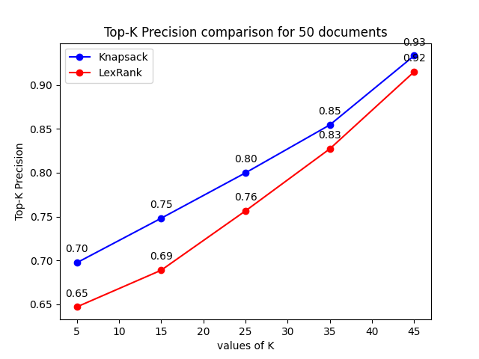
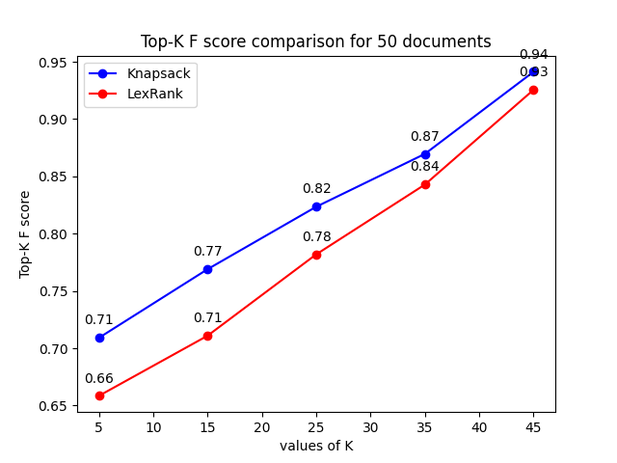
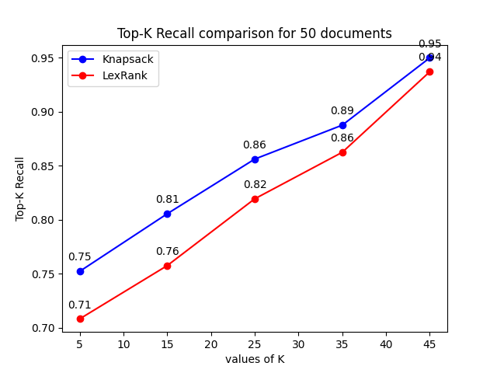
Intrinsic evaluation of Knapsack Summarizer

Slide 19
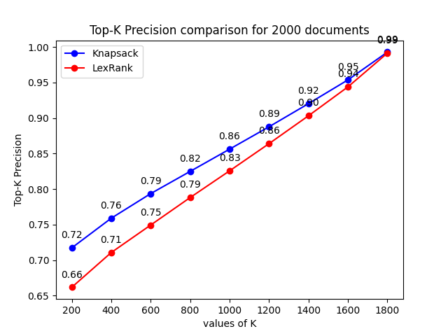
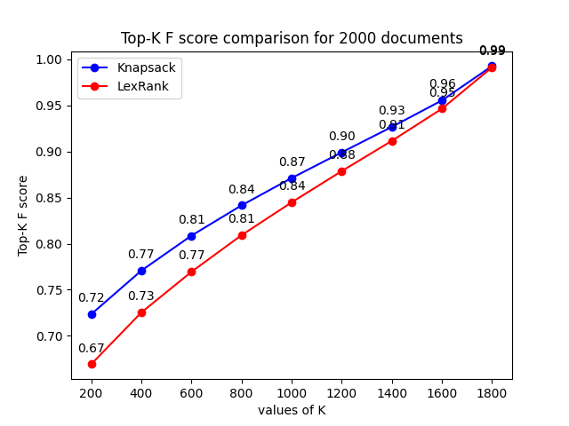
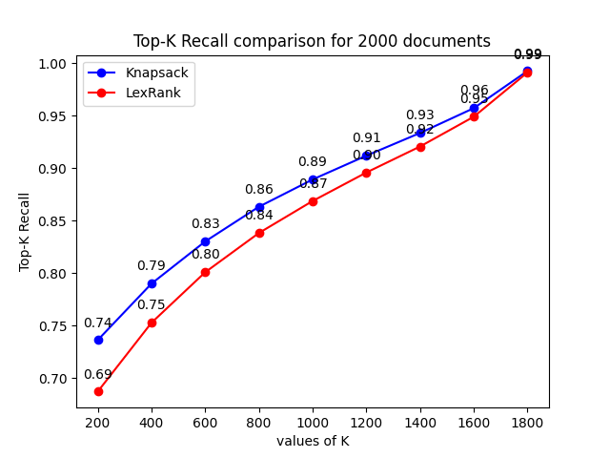
Scaling up to a dataset of 2000 documents

Slide 20
Correlation Analysis
Summarizer | Kendall’s Tau | Spearman’s correlation
Avg Correlation in Knapsack | 0.00976 | 0.01452
Avg Correlation in Lexrank | 0.00783 | 0.01167
Avg p-value in Knapsack | 0.47815 | 0.48018
Avg p-value in Lexrank | 0.48797 | 0.48952

Slide 21
Ablation Study of Summarizers
Algorithm | Concept
TextRank | PageRank for text
LexRank | Cosine similarity for sentence similarity
LSA | SVD to represent text as a matrix
Luhn's | Ranks sentences based on the frequency of important words
KLSum | Uses KL divergence to measure sentence similarity
SumBasic | Ranks sentences based on the frequency of important words

Slide 22
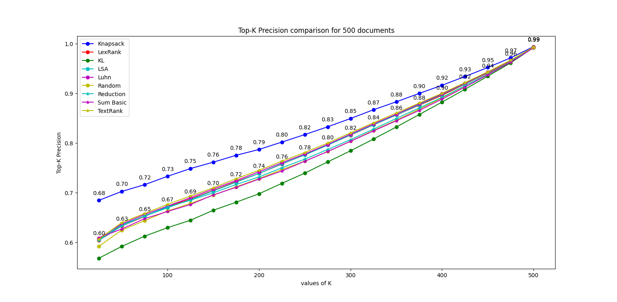
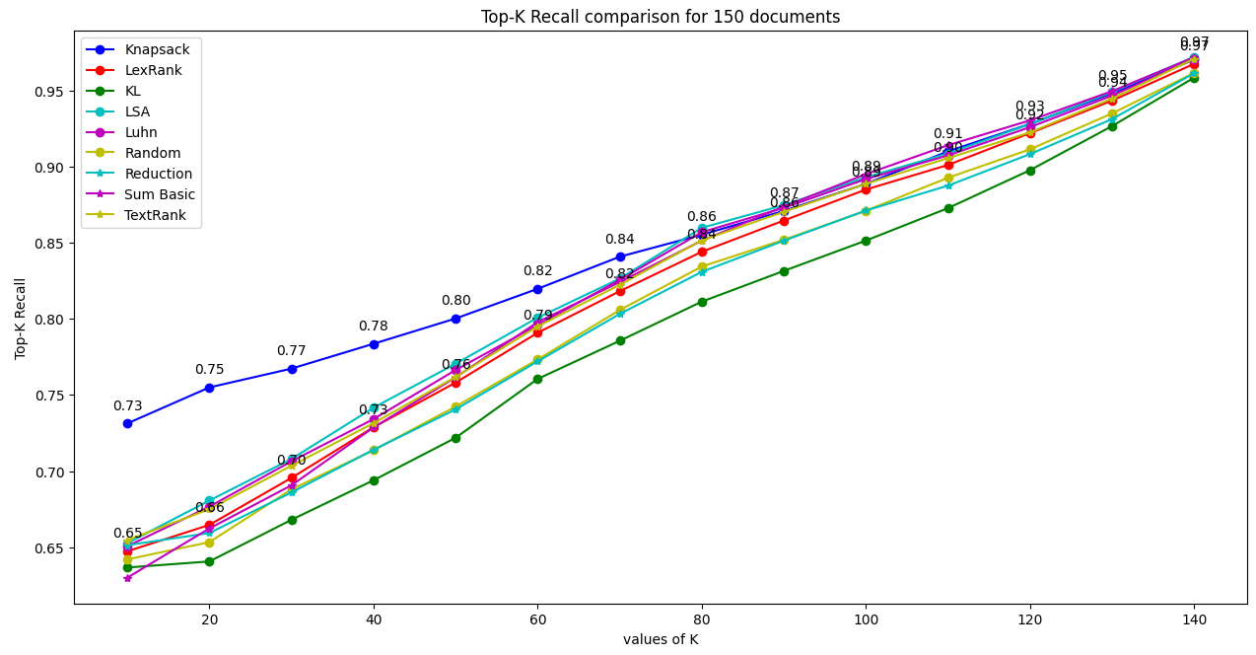
Results on a corpus of 500 documents

Slide 23
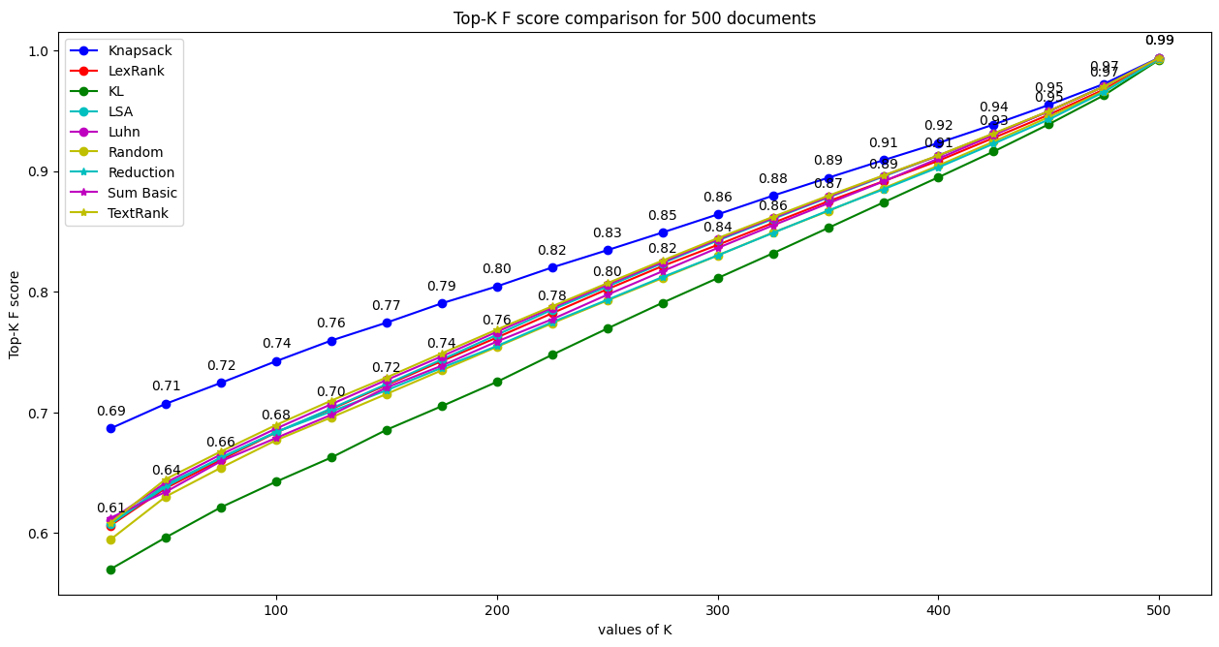

Slide 24
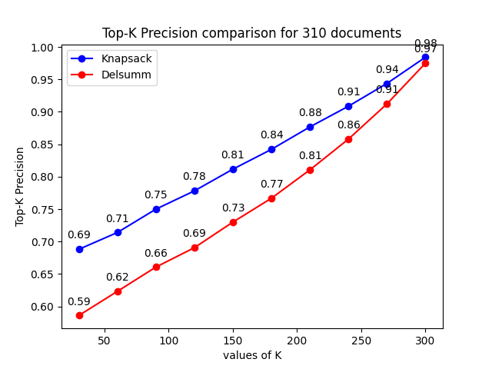
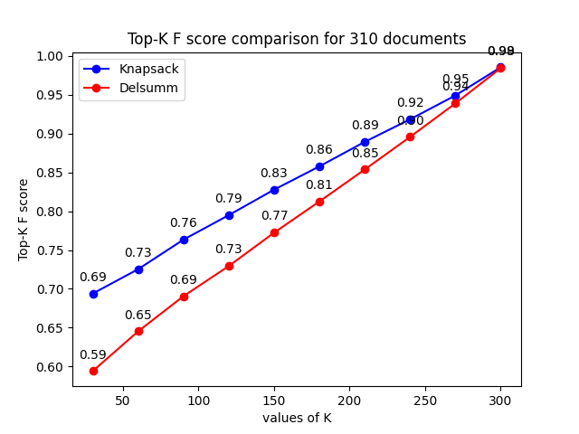
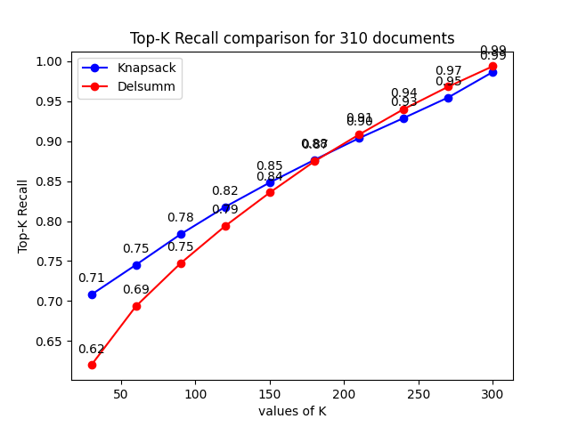
Domain specific extractive summarizer

Slide 25
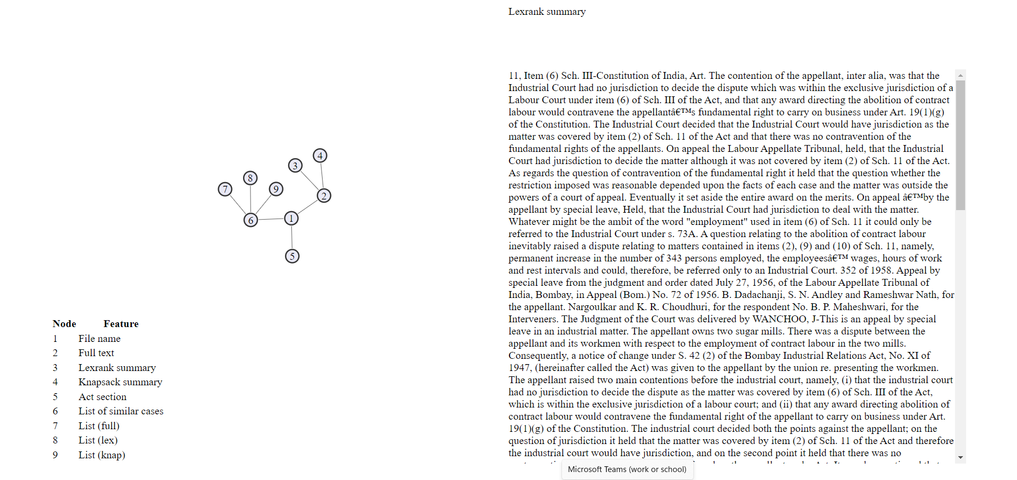
Visual summary

Slide 26
Fetching similar documents dynamically
POSITIVE LIST
1
2
3
d1
d2
D
Q
1
DOUBTFUL LIST
a
b
c
d
e
d1
d2
similarity >> threshold
similarity > threshold
D
d1
d2
SIMILARITY LIST
A
B
C
D

Slide 27
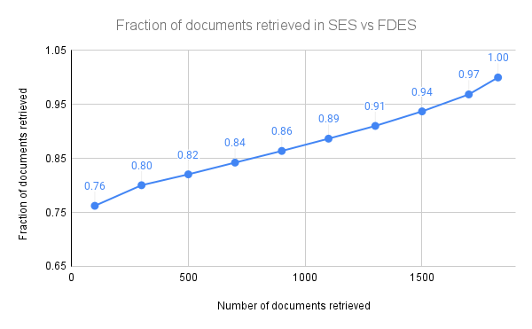

Slide 28
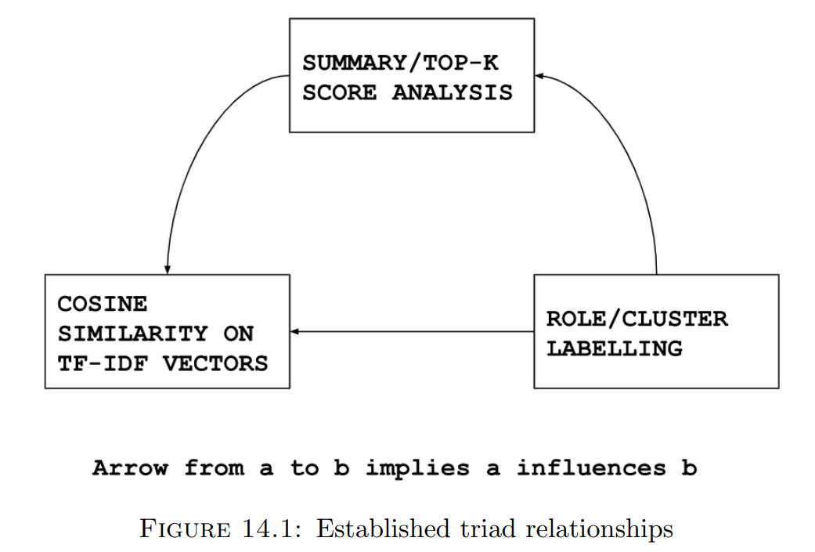
Relations established in the Triad
Knapsack summarizer
Correlation results, ROUGE scores, extrinsic evaluation to show consistency
Dynamic fetch algorithm
Rule based and Cluster based approaches

Slide 29
Future scope
To explore the visual summary data structure in more detail and to add more features.
To implement a structured case display based on a concept graph and to retrieve the similarity of documents based on different clusters/roles
To establish entailment relationships in the document flow concerning role labels
To Perform a quantitative ablation study on clustering and its effect on the Knapsack summarizer

Slide 30
THANK YOU

Slide 31
Review of literature
Link to detailed Literature review

Slide 32
Legal document similarity: a multi-criteria decision-making perspective
Wagh RS, Anand D. 2020. PeerJ Computer Science 6:e262 https://doi.org/10.7717/peerj-cs.262
Ideas proposed by the paper: Approach of concept based similarity estimation using graph-based method to identify prominent concepts in a judgment and extract sentences representative of these concepts. In our case, each sentence has been clustered into one of the 7 clusters. The main concept covered by each cluster is called the topic of the cluster. We have tried to use these cluster labels for cluster role labelling (as corresponding to rhetorical role labelling) of the documents.

Slide 33
Towards Reducing the Pendency of Cases at Court: Automated Case Analysis of Supreme Court Judgments in India
Pandey, Shubham & Chandra, Ayan & Sarkar, Sudeshna & Shankar, Uday. (2021). 10.3233/FAIA210321.
Ideas proposed by the paper: To increase the existing role labels to the concept of Case Analysis labels and to apply rule based approaches to label the same. In our case, for identification of rhetorical roles, rule based techniques have been employed. The idea of having case labels is extended to assigning multiple cluster labels or role labels to the sentences of the legal document.

